Slide 1
Objective 2
Develop a regression model to predict box office profits based on the following key features:
1. Production Budget: The financial investment required to produce the film.
2. Genre: The category or type of movie (e.g., action, drama, comedy).
3. Runtime: The duration of the movie in minutes.
4. Release Date: The timing of the film's release, which may impact audience turnout.
5. Domestic Gross Revenue: The total revenue generated within the domestic market.
6. Worldwide Gross Revenue: The total revenue generated globally.
7. Foreign Gross Revenue: The revenue generated outside the domestic market.
8. Ratings: Audience and critic reviews, reflecting the perceived quality of the movie.
9. Number of Votes: The total number of ratings received, indicating audience engagement.
This model aims to forecast profitability for upcoming projects, enabling the studio to make data-driven decisions regarding production, marketing, and release strategies.

Slide 2
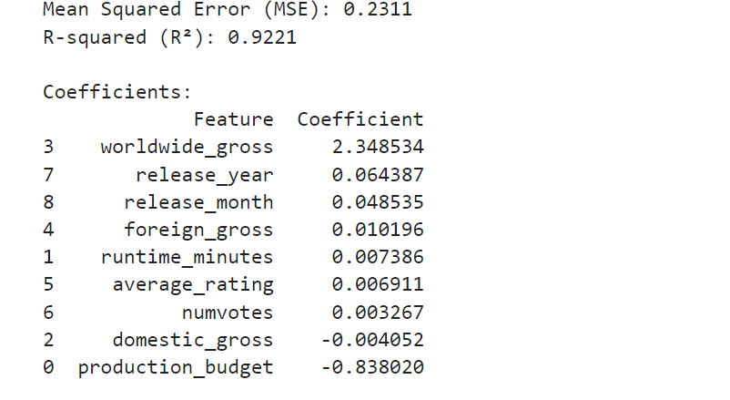
Model coefficients

Slide 3
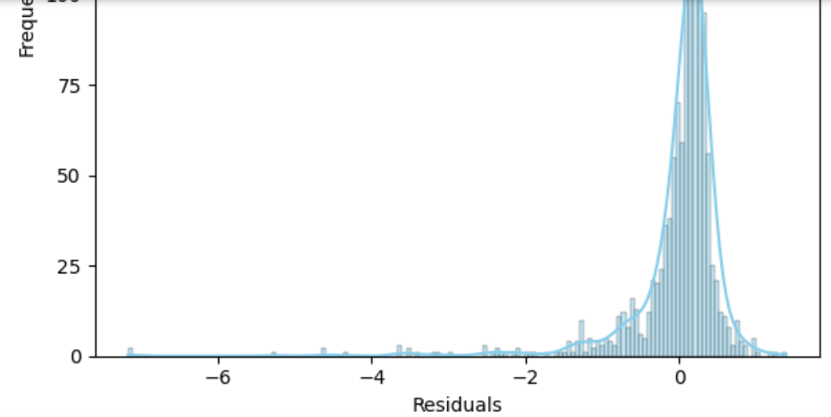
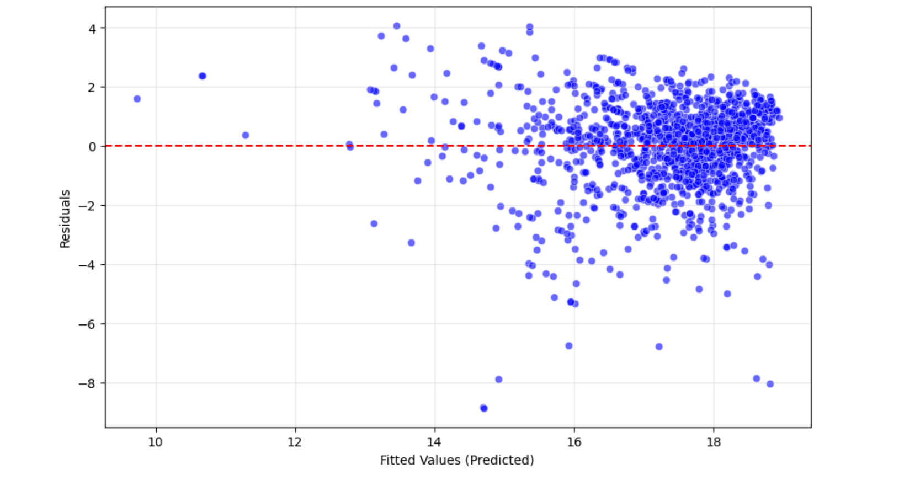
Analysis
The model explains 92.21% of the variability of the data
However, even after transformation, the model fails the Normality and Homoscedastic test as shown below, indicating the need to go for non linear models.

